Slide 1

Hero Sightings

Slide 2
Goals
A Website to track the movements of SuperHeros.
Needs to track locations, organizations of the superheros, sightings, and their superpowers.
I gave it a twist while staying within these parameters. I made it a website to track heros from Classical Literature.

Slide 3
Goals
To accomplish that, I needed a datalayer, backend java (dao, controller) and I needed front end jsps with HTML, CSS, Bootstrap
As stretch goals I had it in mind to pull up pictures of a given hero, and to plot them on a little map of the Mediterranean World of Homer. I will end up doing both of those things, I have leads on the map.
This is going to be my pet project here going forward. I want to make this a cool Classics site

Slide 4
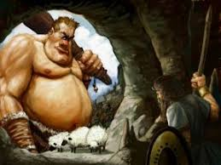
SQL

Slide 5
SQL
Two SQL databases, one for production, and the other for testing I created tables for each DTO in my java, so Sightings, Superheros, superpowers, locations, and organizations.
As these title are all plural, they all of these tables with the exception of locations needed bridge tables to express a many to many relationship
Sightings and Organizations had one to many relationships with locations

Slide 6
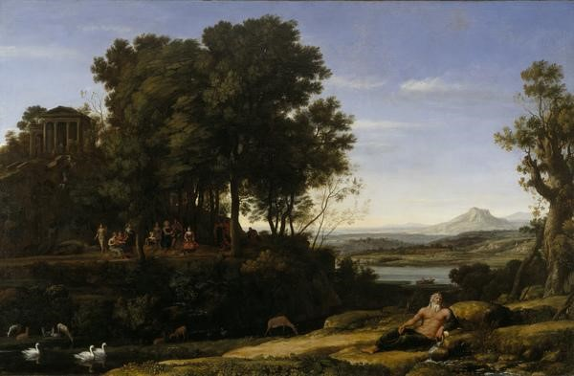
Java

Slide 7
Java Back End
No service layer, though I was tempted to create one.
I started with a Controller for each DTO, then moved to two (one an REST controller) but then I switched to one Controller only towards the end of my project.
5 DTOs, as mentioned.
One DAO Interface and a DAOImpl, which is my engine room

Slide 8
Java Back End
I used the Spring Framework to wire all of my classes together with loose coupling
I used prepared statements to access my SQL data layer, via the Spring Framework

Slide 9
Java Back End
Another Flex Goal of mine was to have a Search Controller, like in our Contacts assignment
I ran out of time to implement that

Slide 10
Java Front End
I used JSPs within the provided Software Guild web servlet template to create my web pages
Tomcat was what I used to do the black magic of request and response
I incorporated HTML, CSS, bootstrap, and JavaScripts to accomplish all of this
I tried to incoporate Ajax, I may well try again as I want to understand it better than I do at the present.

Slide 11
Java Front End
I created pages for each DTO. Like in Contacts, these pages show all in my system (a limited amount for now).
Each of these pages has a form to add a new DTO, and for each in the list of all of my DTOs, the viewer has the option to view, edit, or delete each object.
A seperate page comes up to take in updates for a given DTO.
A seperate page comes up for displaying all details

Slide 12
Java Front End
A seperate page comes up to take in updates for a given DTO.
A seperate page comes up for displaying all the properties of a specific, clicked on (requested) object.
The Home Page (index) ties all of these together.
You may access each DTO's page from there, and then more information about each DTO from the main page of that DTO

Slide 13
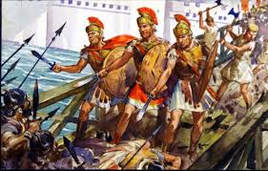
Thanks

